Slide 1
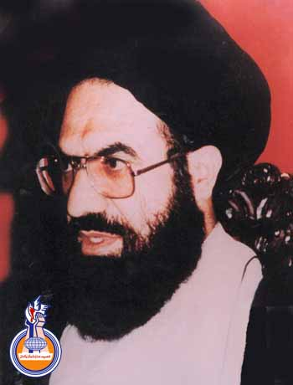
Safeer e Noor II
-Tasleem Raza Khan

Slide 2
Contents
Inqilab e Islami Iran
Shaheed Quaid aur amli siyasat
Quran o sunnat conferences
Imam Khomenei r.a se Ishq
Mulazmeen se rawaiyya
PART II (will present next time…)

Slide 3
Inqilab e Islami Iran
Imam Khomenei ki himayat
Iran Iraq War
Mukhtalif jalso aur tarbiyati camps main imam khomenei ki himayat
Afkaar e Khomenei r.a aur tasaveer ka mulk bhr main circulate krna
Jihad
War zone main jana
Islami mumalik k hukumrano ko khatoot likhna

Slide 4
Shaheed Quaid aur amli siyasat
Tehreek e nifaz e fiqh e jaffaria Pakistan ka bahesiyat siyasi jamaat bnna
Imam Khomenei k afkar ko shiaar banana
Deen o siyast ki zaroorat
Zia referendum ka boycott

Slide 5
Quran o sunnat conferences
Laakhon afraad ki shirkat
Farzandaan e quran
Farzandan e sunnat
Pakistan banane k maqasid

Slide 6
Imam Khomenei r.a se Ishq
Roohani baap
Numainda e Wali Faqih
Mutarjimeen se farmish
Mulk geer daura jaat
Imam Khomenei ki ziarat k waqt…
Wafat e khomenei k baare main jumla sun k reaction…

Slide 7
Mulazmeen se rawaiyya
Daftari afraad se
Bachon ko thappar marna
Bache ko bnd kr dna
Mehmaan se larai

